Slide 1
SMS Reader
By:
Rahmah C. Hadji Abdulmadid

Slide 2
Description
SMS Reader is an android mobile application that reads SMS.

Slide 3
Functionality
Manage Read Message
- Message will be read out loud from selected contacts only.

Slide 4
Significance to society
Eye Disorder

Slide 5
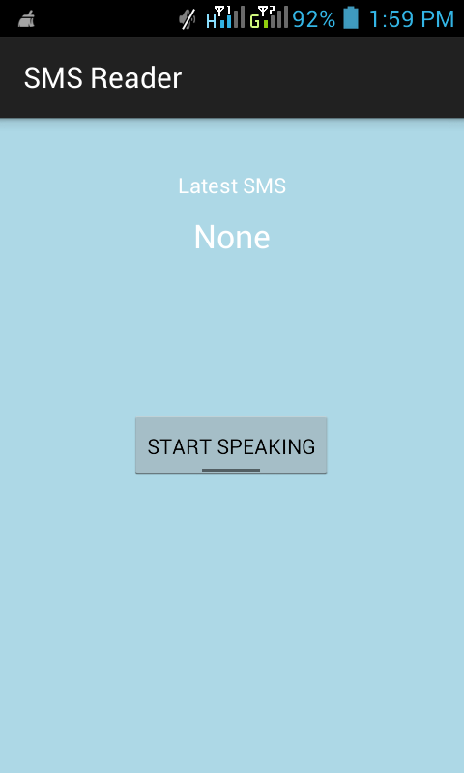
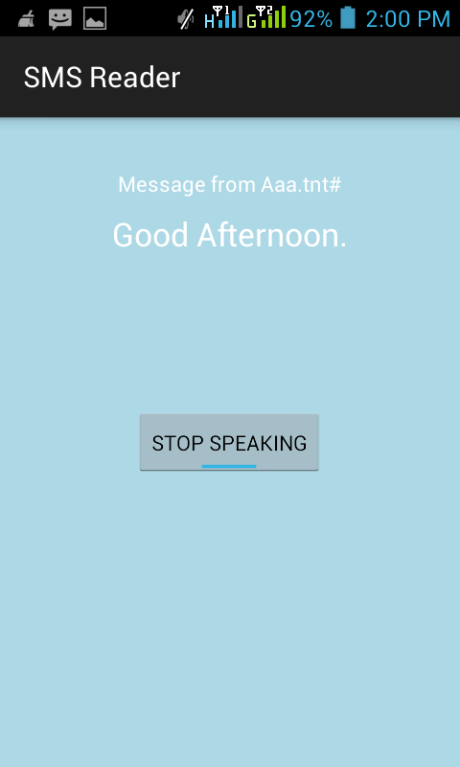
User interface

